Slide 1
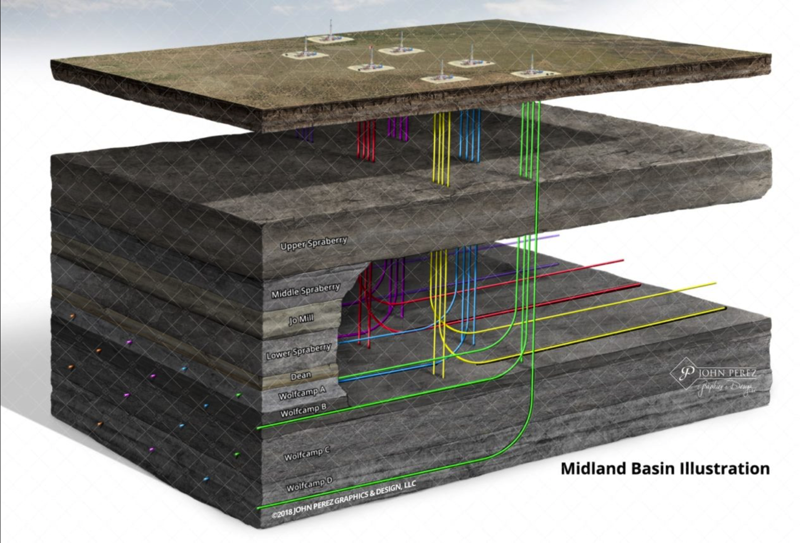
FTNF Report for CTOP
Finding Productive Oil Wells in the West Texas Permian Basin
Peter Flaming Matthew Trevathan Quinton Nixon Brock Friedrich

Slide 2
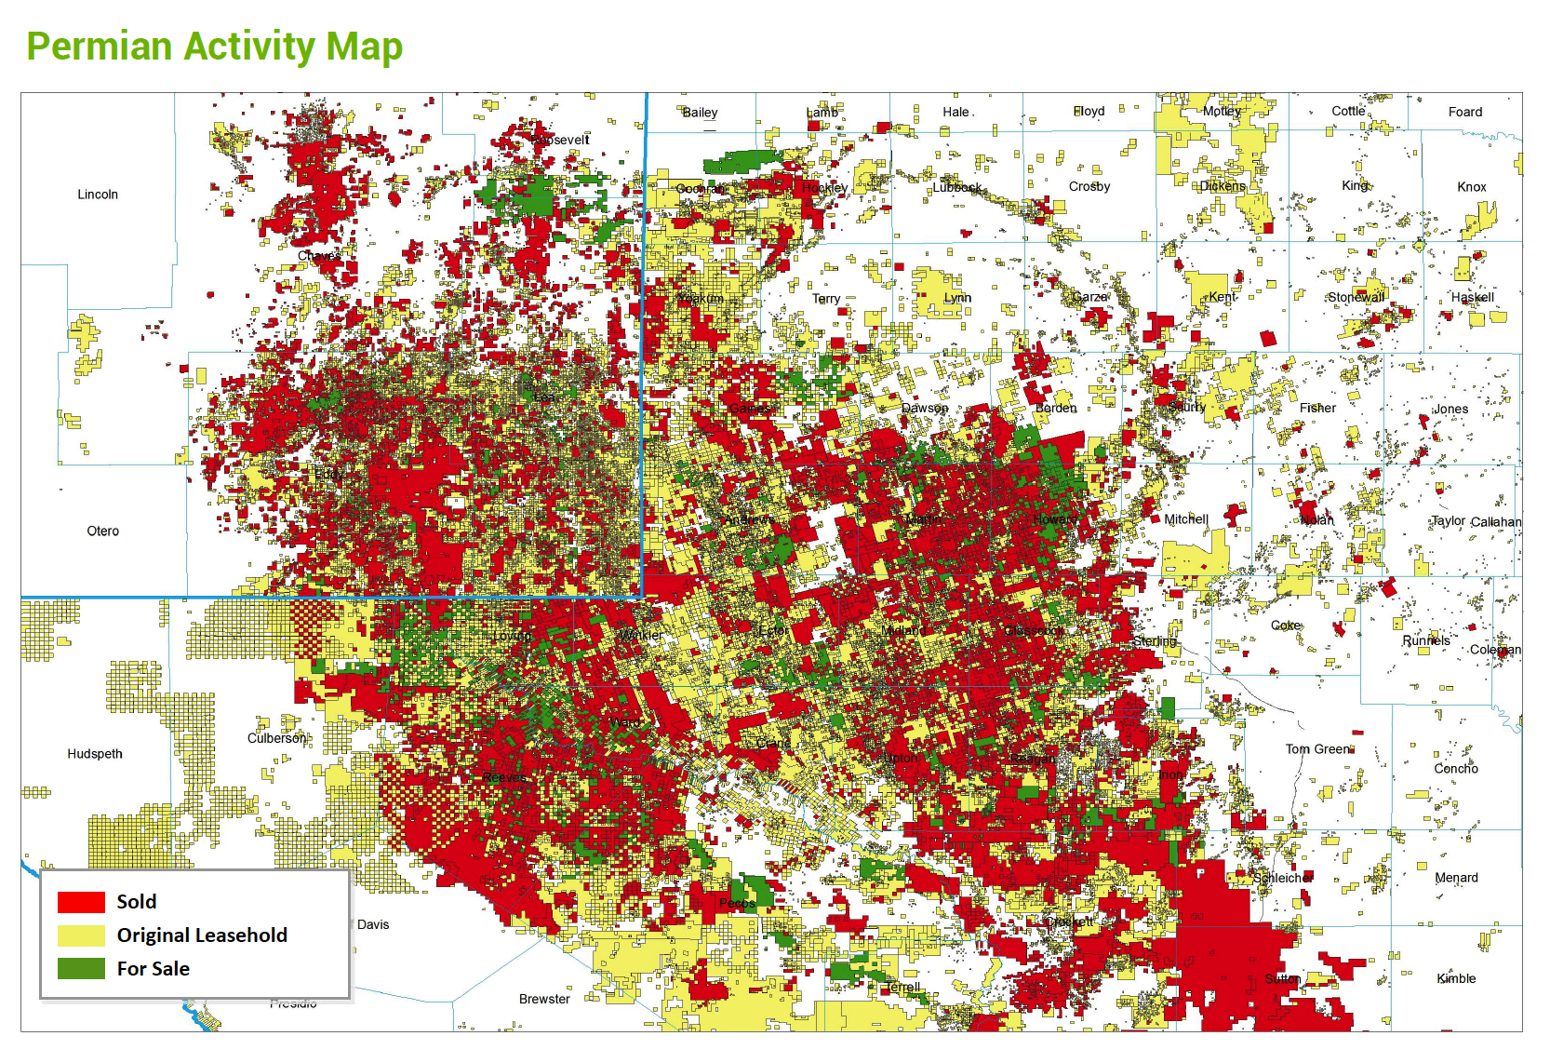

Study Outline
Business Objectives
Data Sourced
Methodology
Evaluation/Results
Summary
Page 2

Slide 3
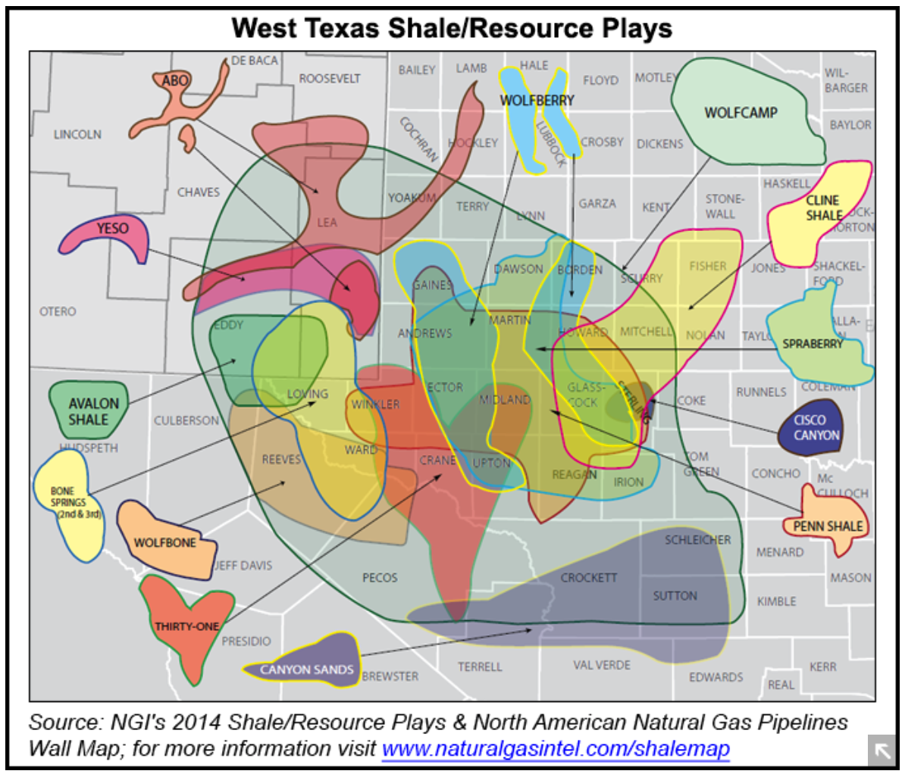
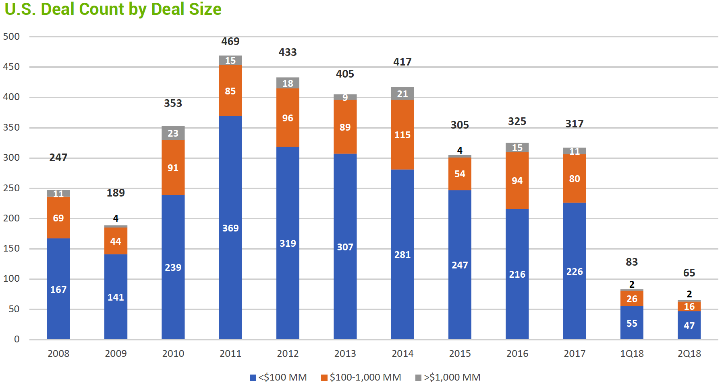
Business Objectives
Find Data to improve predictions
Uncover Key Aspects
Produce Quantified Results
Determine Trends
Recommend Top Plays
Market Overview
Where to deal and what to play?
Page 3

Slide 4
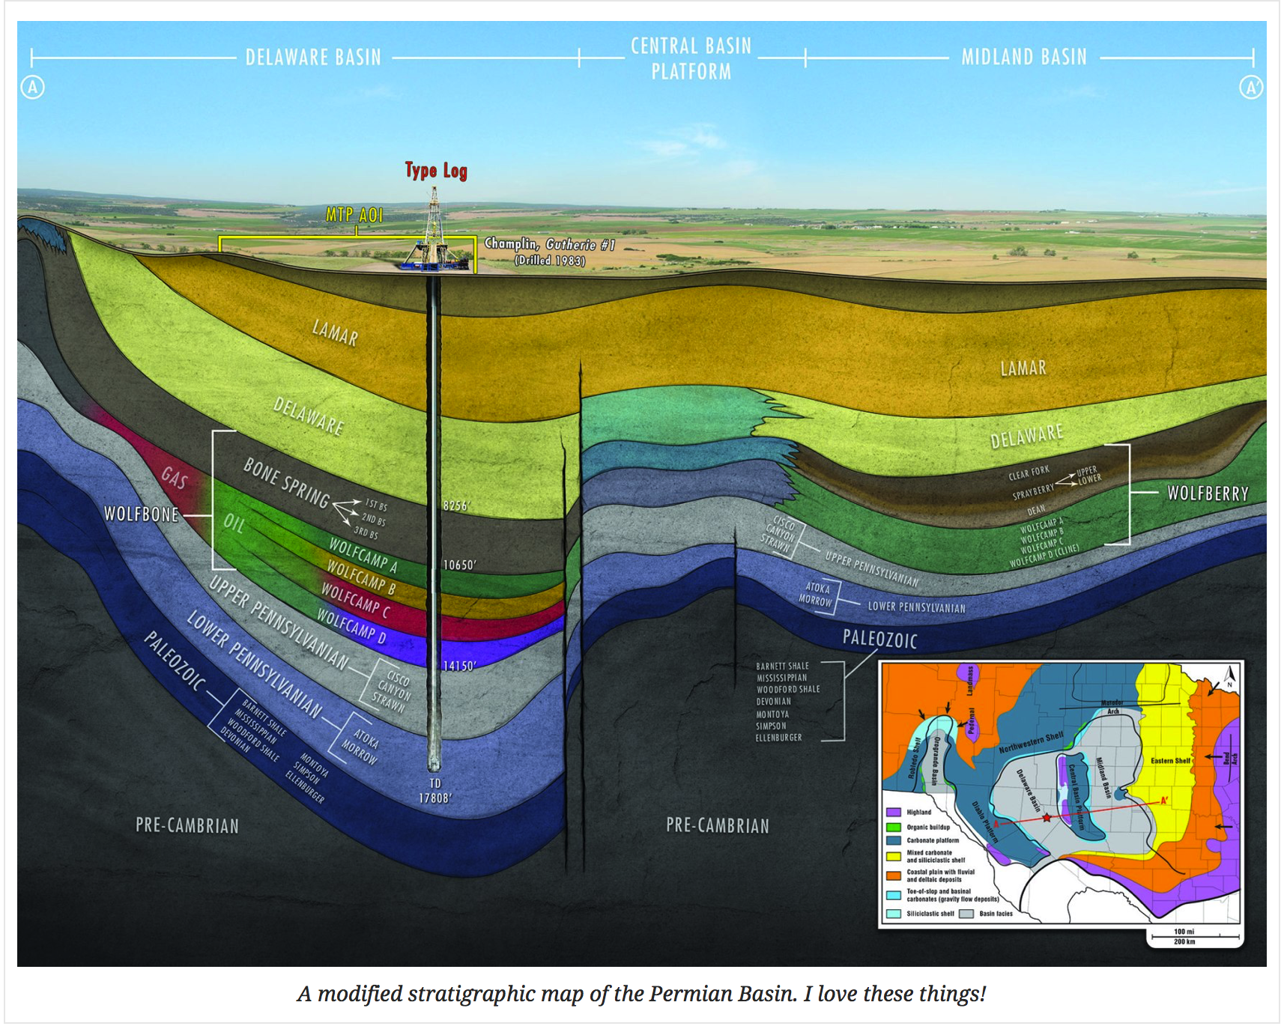
Research Questions
Questions
Does well productivity increase with 'frac size’? If so, how?
Are there regional trends?
Are there geological trends?
Do additives affect productivity?
Page 4

Slide 5
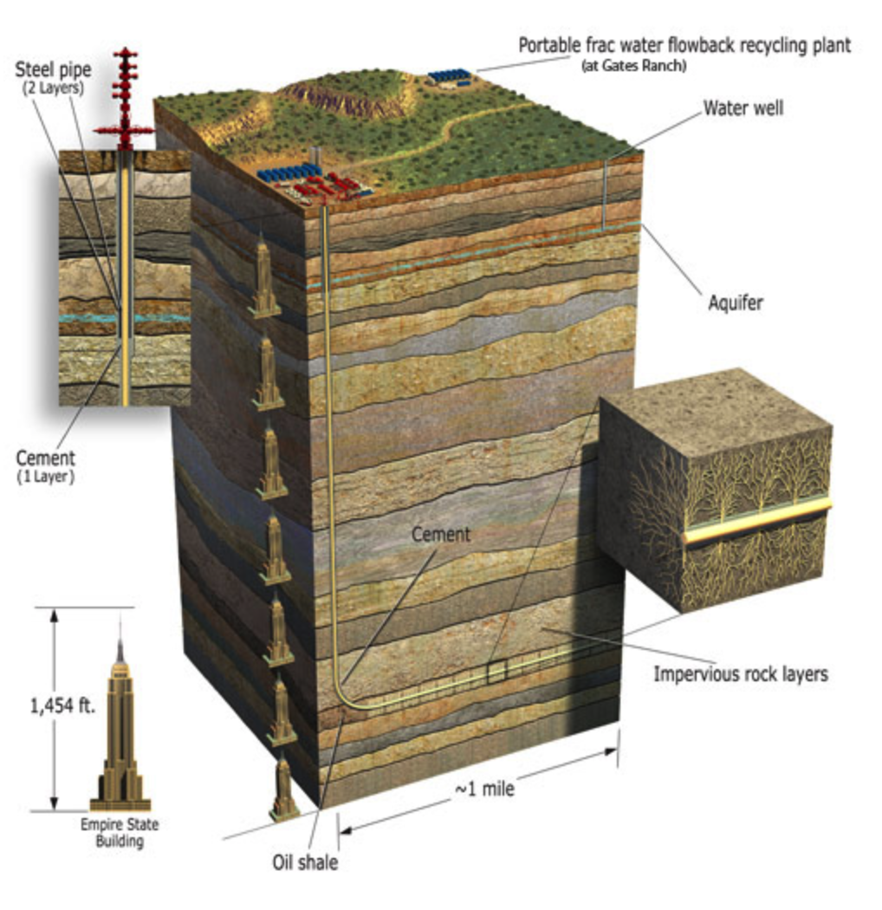
Data Source
Data
Driftwood
fracfocus.org
1,454ft x 5 = ~7300ft =
TVD
Quantify Everything!
Page 5

Slide 6
Data Sources
Client data – in-house dataset with key attributes of areas of interest including geological and operator information. Seven parameters used in the study.
Enriching data – data from a national registry with information about chemicals used in the fracturing process. 19 of 24 parameters used in the study.
Client data tells us who is doing what, enriching data tells us what they are doing it with
Page 6

Slide 7
Methodology
Preparation
Understand the business needs of the client
Gather relevant data to address the needs
Explore, model, and predict
Workflow
Getting and cleaning data
Creating new predictor variables
Exploratory Data Analysis
Feature selection and model building
Interpretation and Conclusions
Page 7

Slide 8
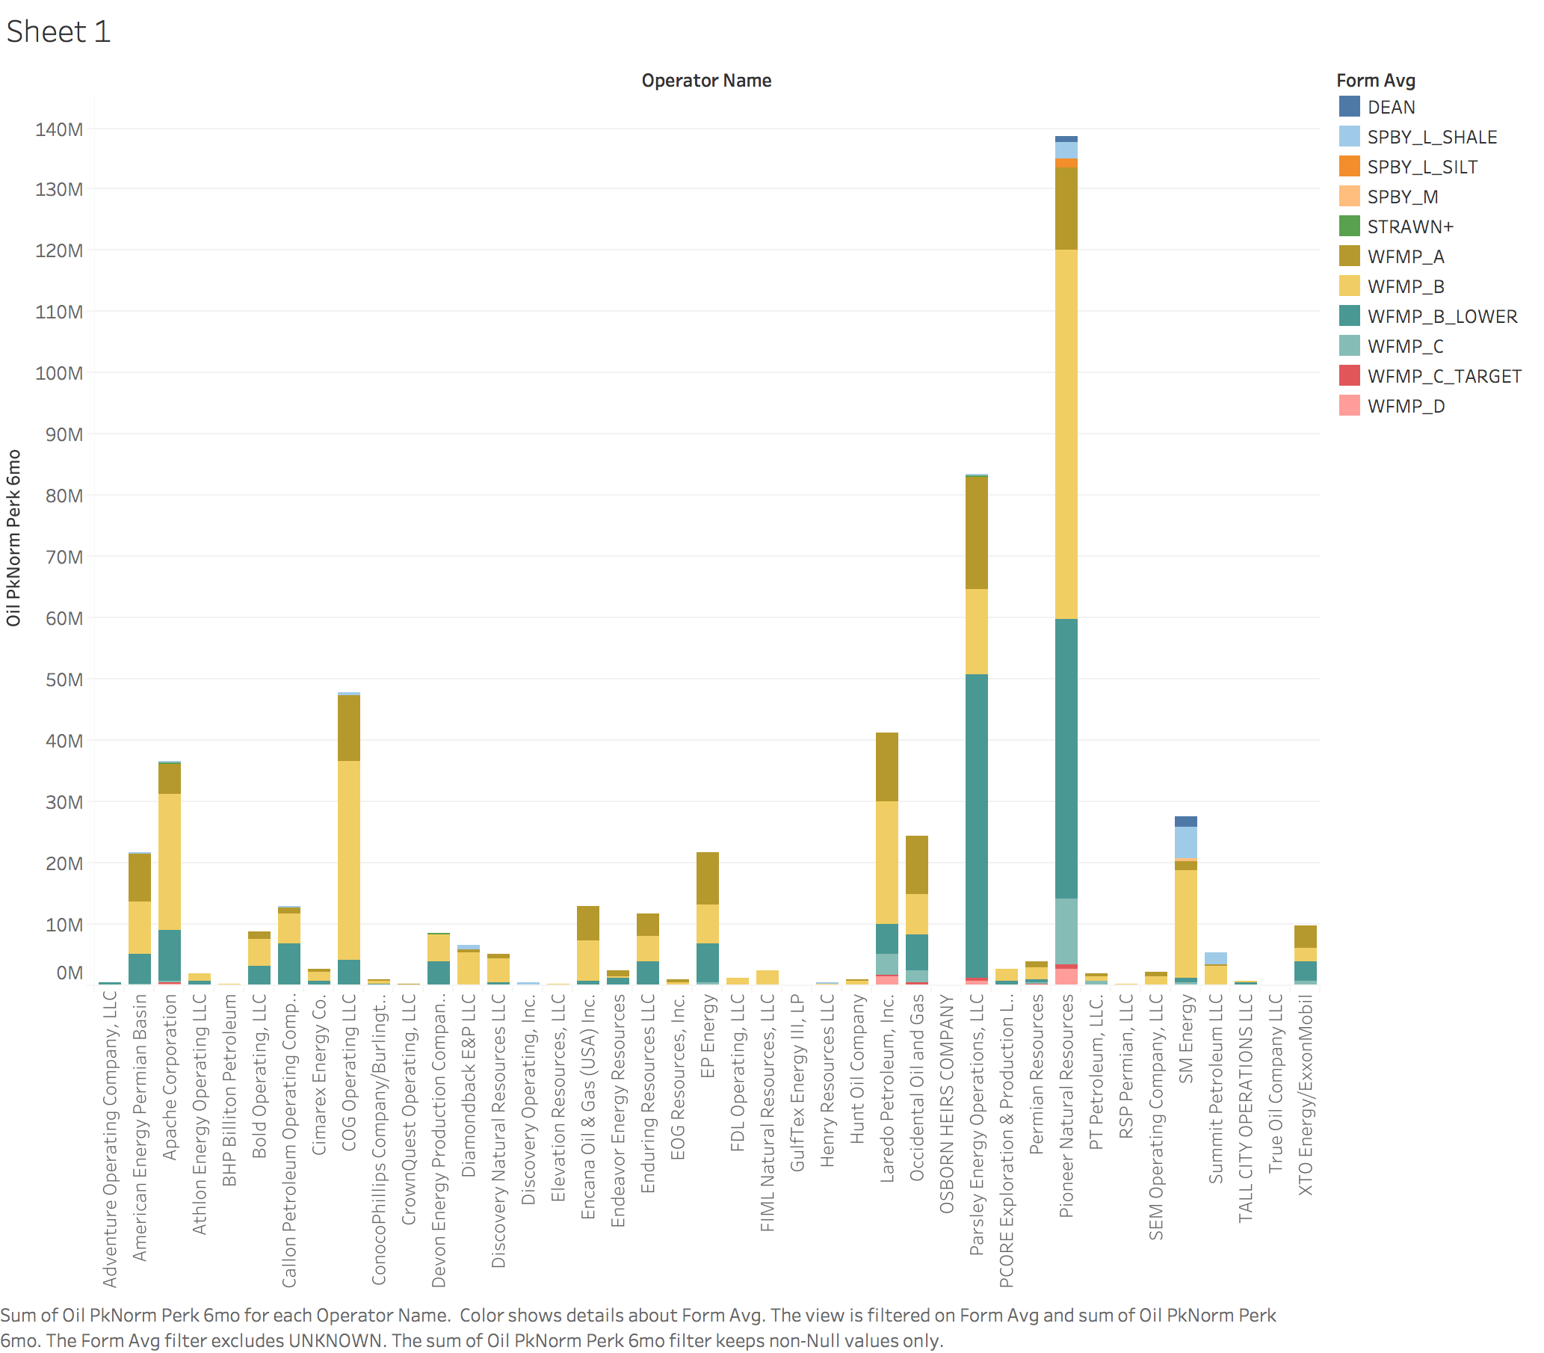
Exploratory Data Analysis
Oil Production by Company
Page 8

Slide 9
Exploratory Data Analysis
Oil Production by Company
Page 9

Slide 10
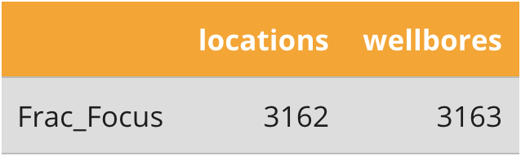
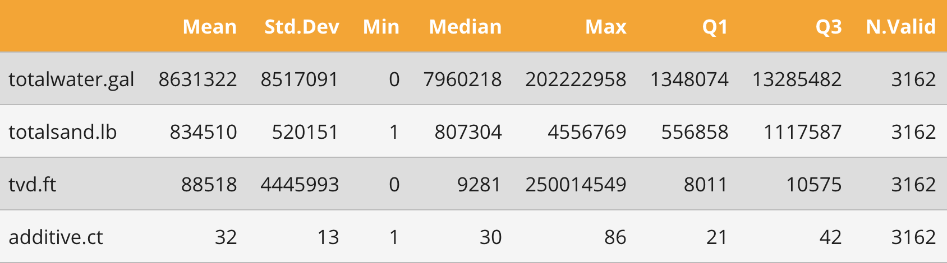
Exploratory Data Analysis
Locations
Aggregate additives
Page 10

Slide 11
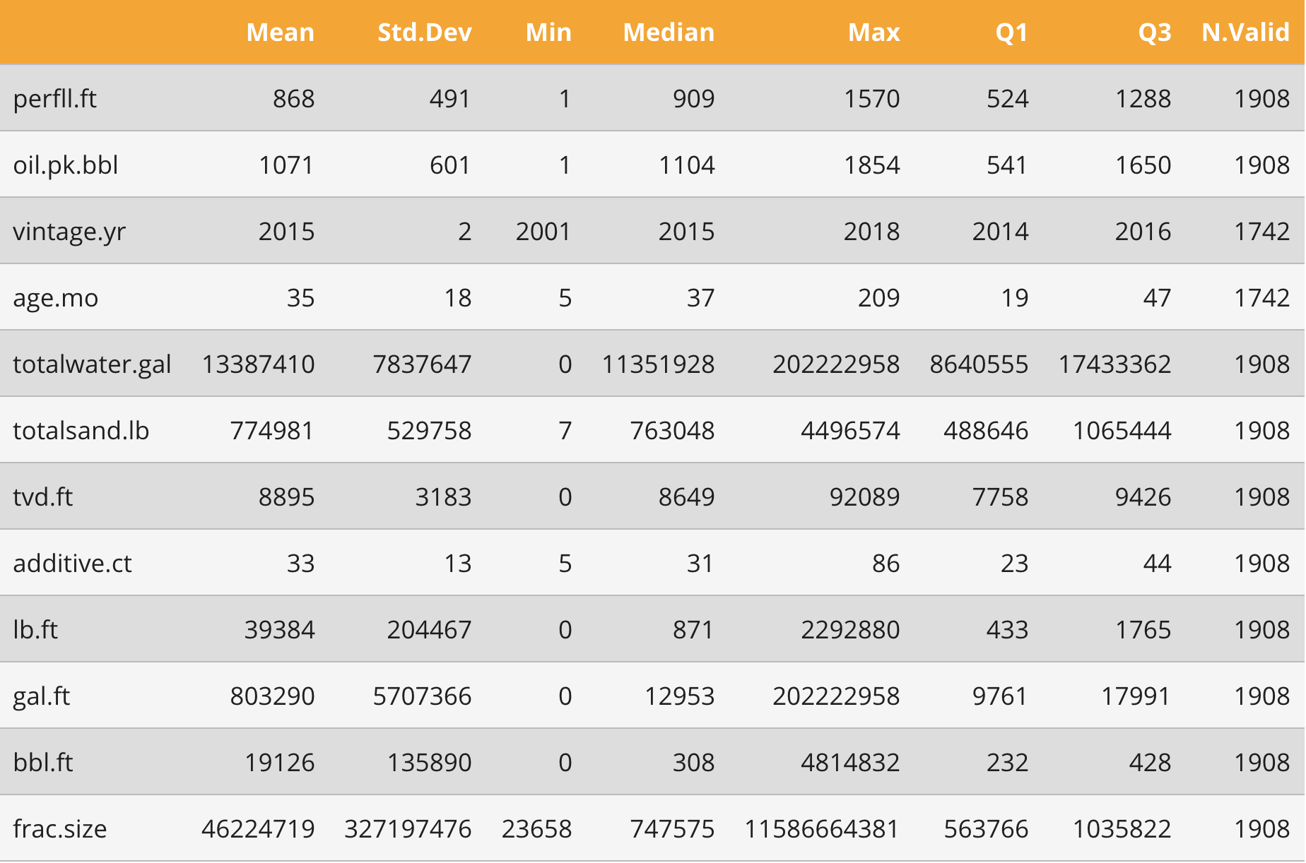
Exploratory Data Analysis
Summary of well data
Page 11

Slide 12
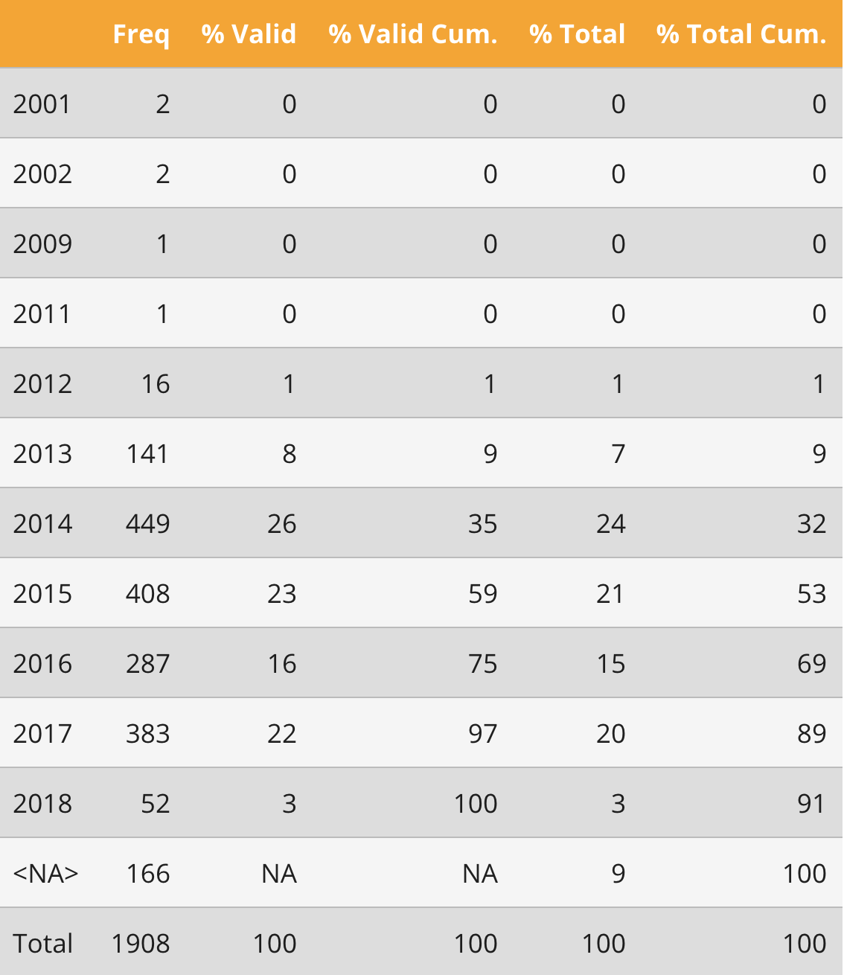
Exploratory Data Analysis
Summary of wells by year
Page 12

Slide 13
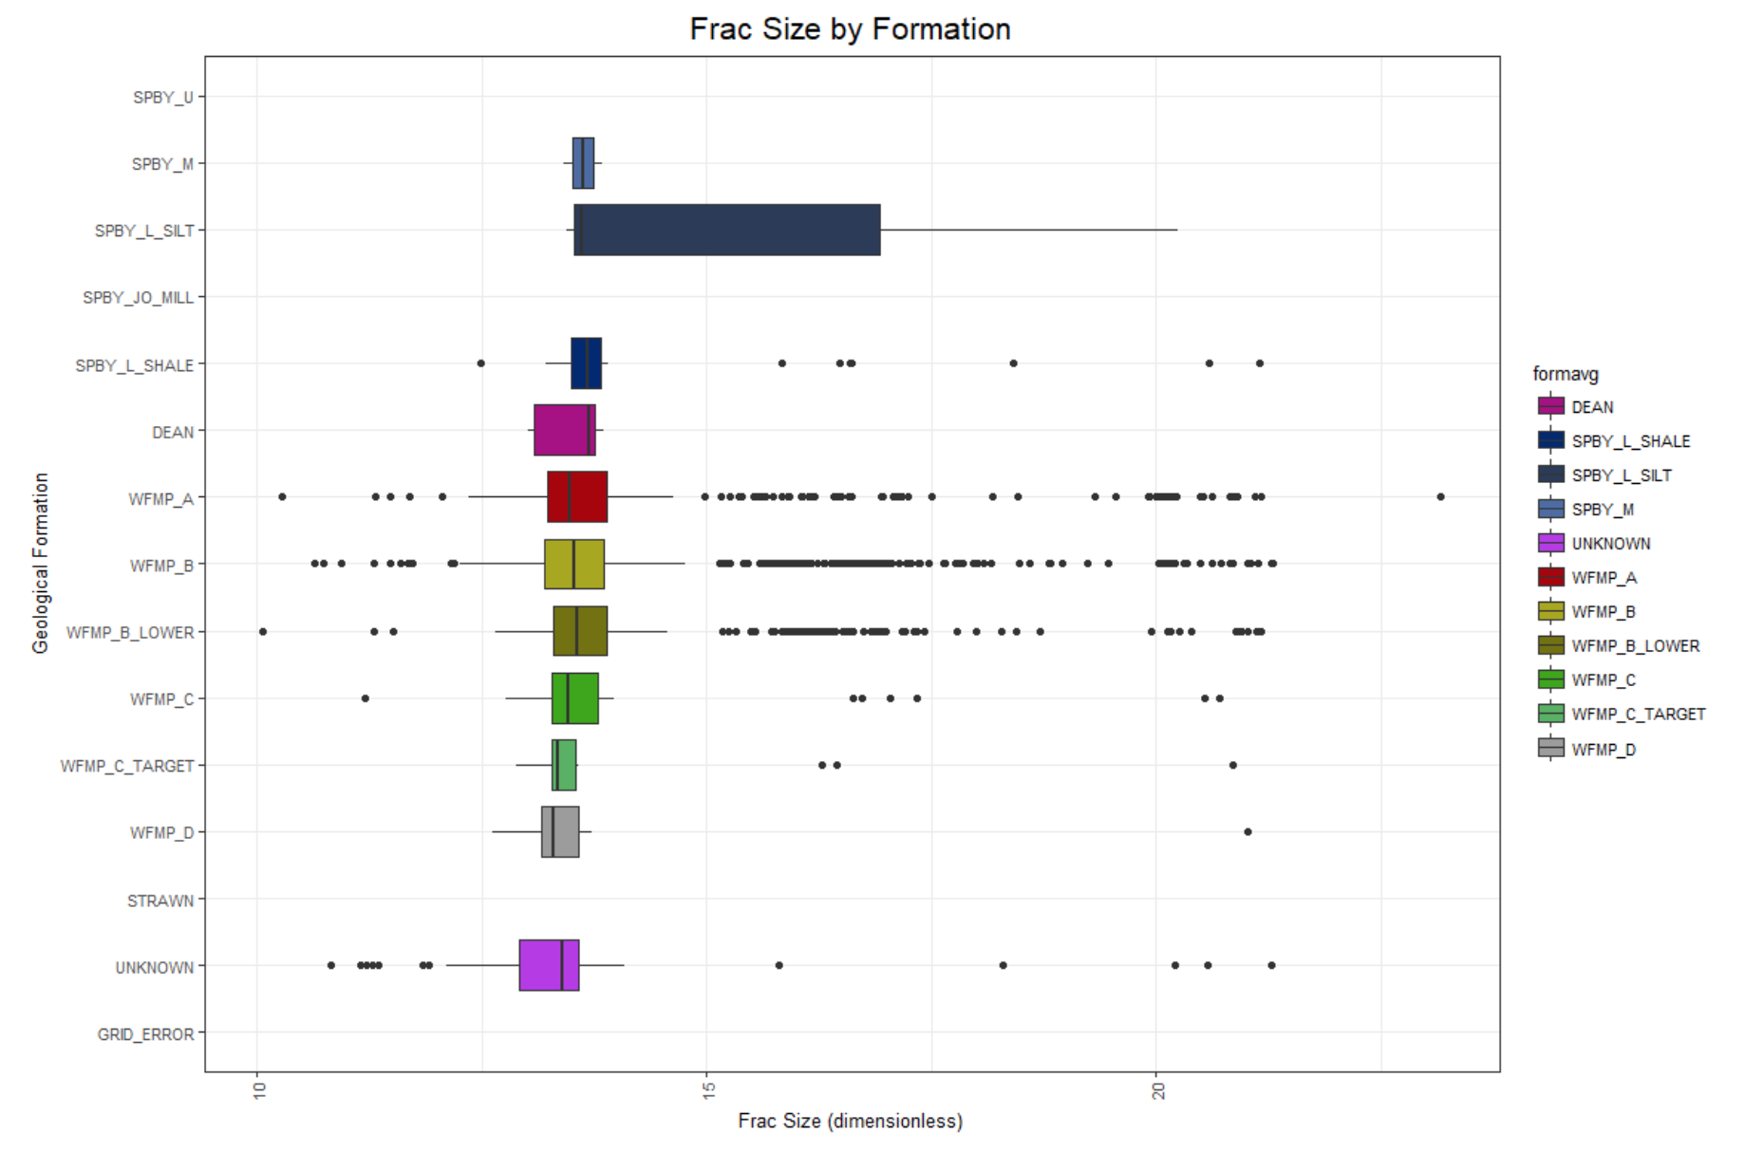
Exploratory Data Analysis
Fracture size by formation
Page 13

Slide 14
Evaluation and Results
Tell me the percentages and why
Show me graphs with explanations
Was your hypothesis correct
Provide any other interesting trends and observations from your analysis
Other things to consider?
Page 14

Slide 15
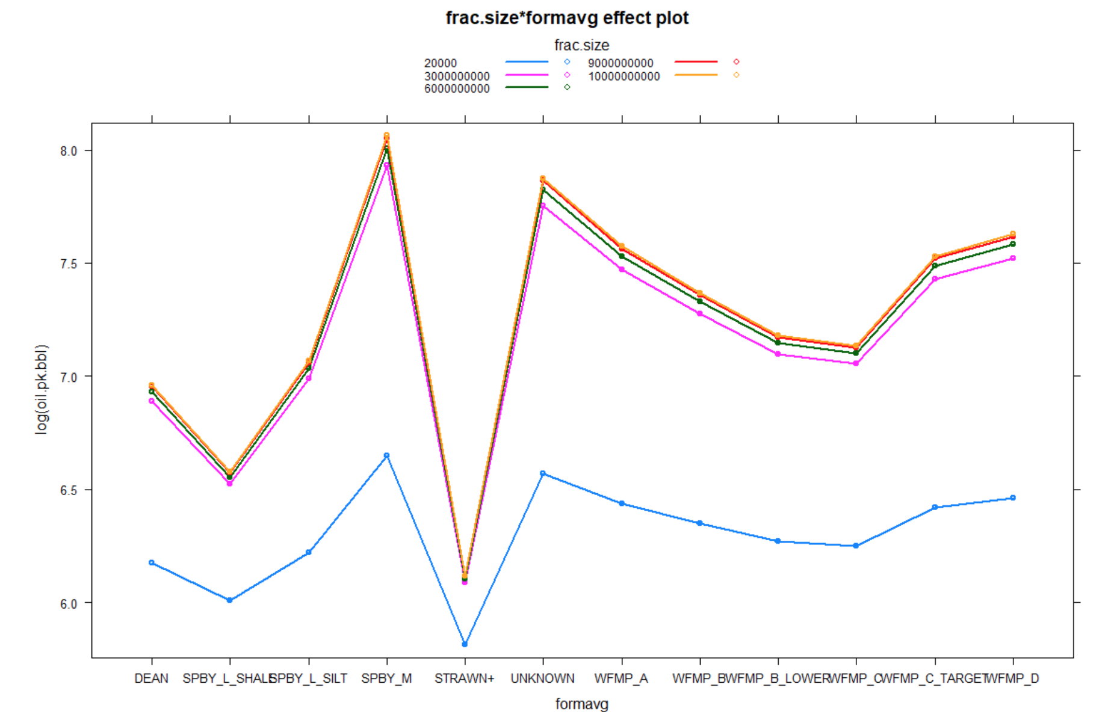
Results
Effect of various additives on frac size
Page 15

Slide 16
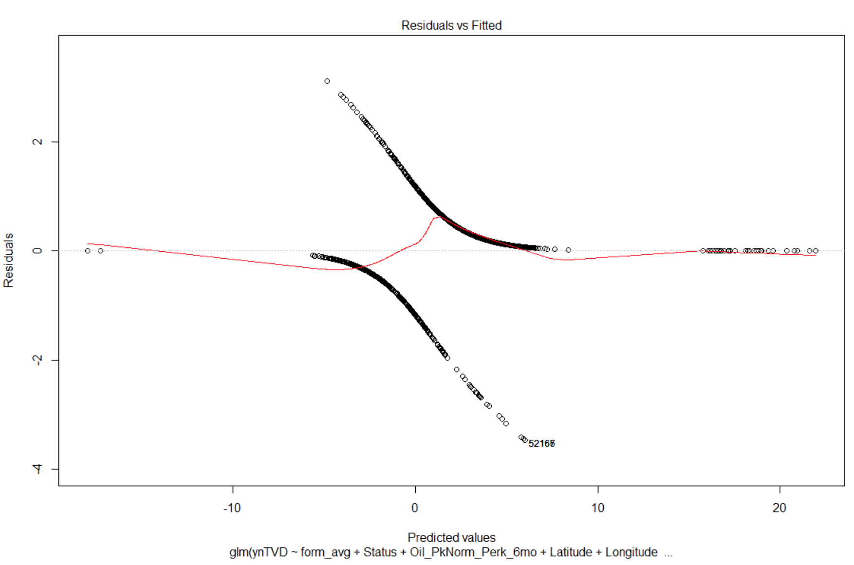
Results
Plot of residuals
Page 16

Slide 17
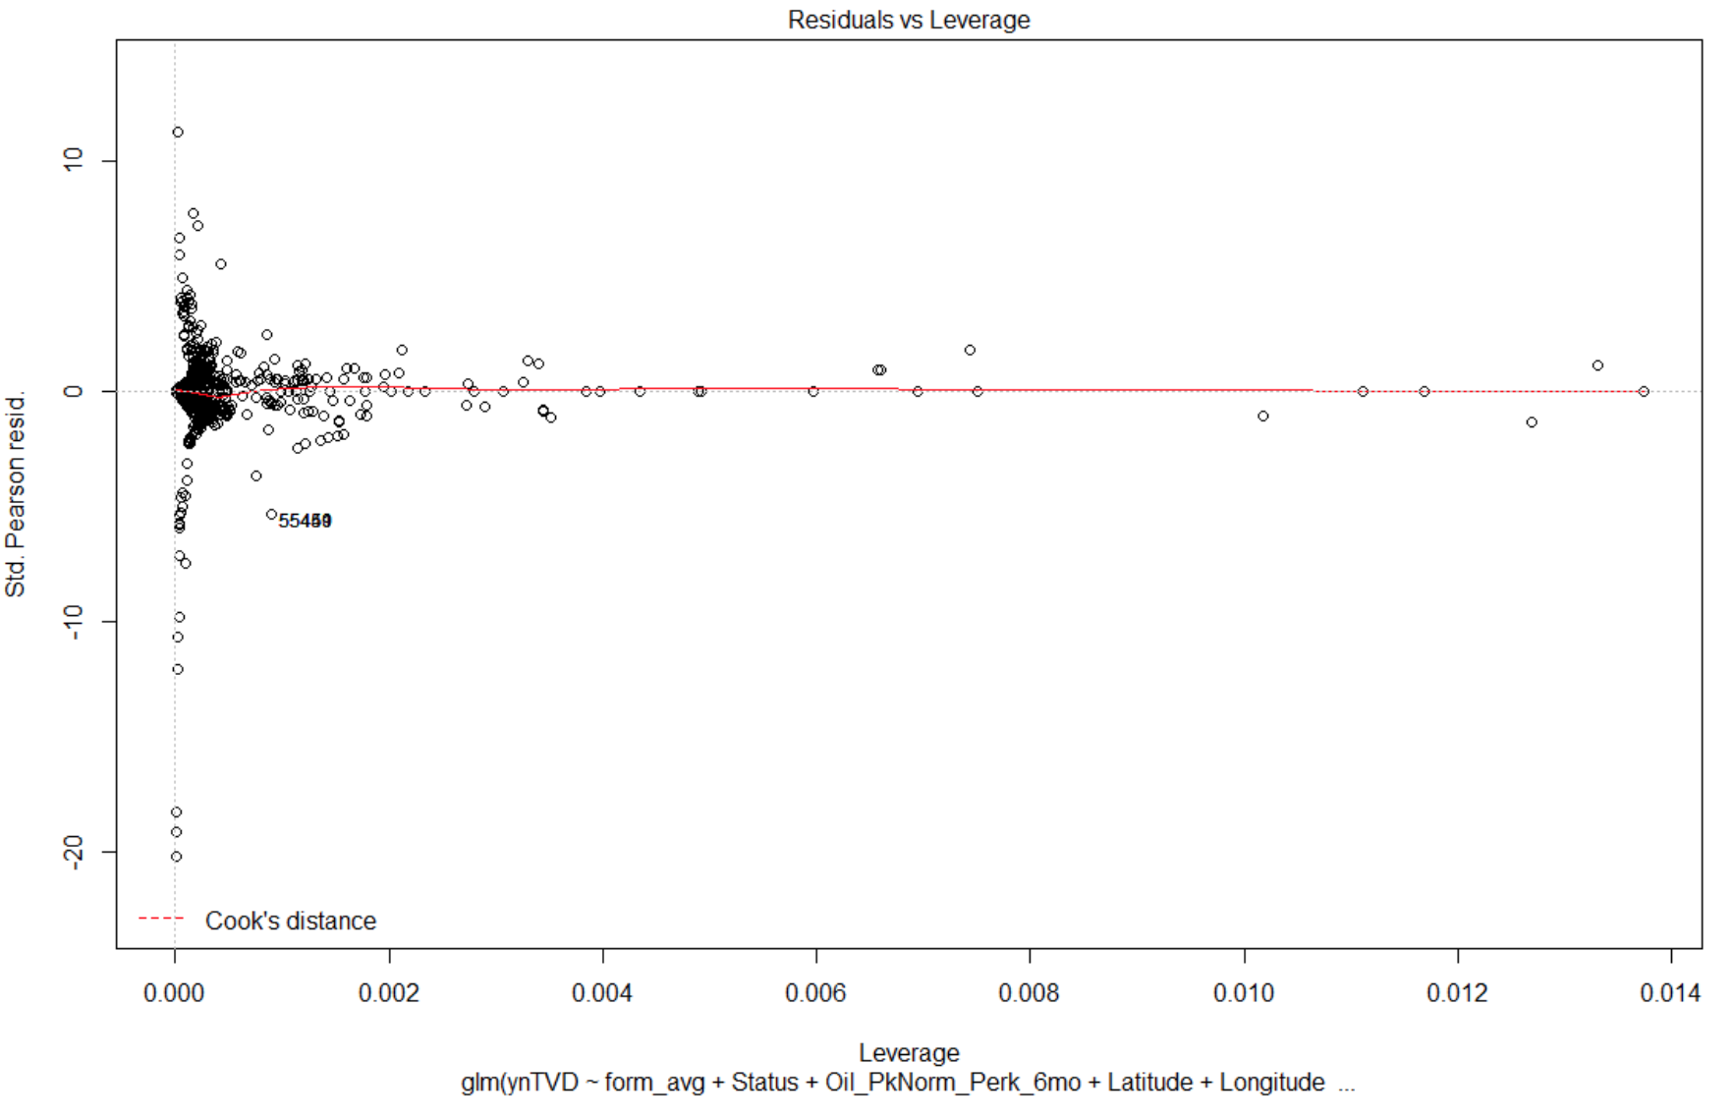
Results
Residuals vs. leverage
Page 17

Slide 18
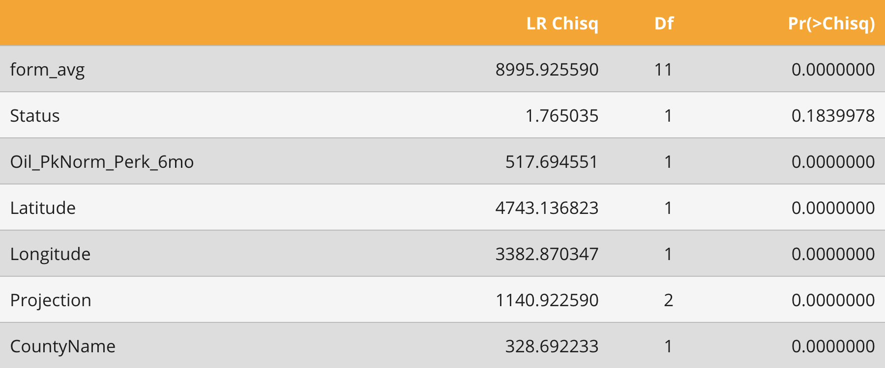
Results
Logistic regression model
Page 18

Slide 19
Summary
Insights
Recommendations
Improvements
Page 19

Slide 20
Questions
Page 20

